Slide 1
Exploration without Map - Lepton-Flavor Violation in LHC era -
J.HISANO
(ICRR, Univ. of Tokyo)
1st Open Meeting of the SuperKEKB Collaboration
KEK, Japan, 10-12 December 2008

Slide 2
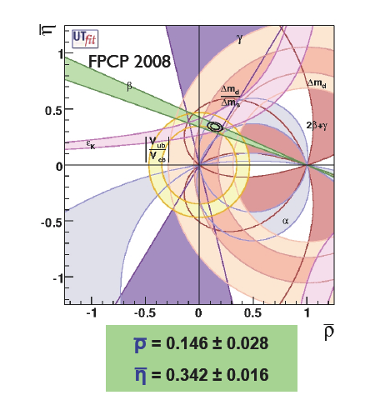
Congratulations! Nambu, Kobahashi and Maskawa Awarded 2008 Nobel Prize in Physics
(Long) history of verification of KM mechanism
Keys: three generations & unitarity of quark mixing matrix
Both developments
in high-energy and high-intensity frontiers
lead to this achievement.
Birth of KM mechanism (73)
Tau lepton (75) and Y(bbbar) (77)
B meson mixing (81)
Direct CP violation(88) and
its confirmation (99)
Top quark (99)
CP violation in B meson system (01)
Awarded Nobel prize (08)
But, the most important point is that
we had got a good map (theory).

Slide 3
Exploration of TEV-scale Physics without Map
Dark matter
Baryon asymmetry
(Inflation)
Beyond the SM at TeVs
New symmetries
New particles
New interactions
new flavor structure
What we know ?
Something at TeVs
for naturalness
Something at TeVs
for naturalness
Superstring
Standard Model
(+ neutrino mass)
Supersymmetry
Extra-dimension

Slide 4
Exploration of TEV-scale Physics without Map
Dark matter
Baryon asymmetry
(Inflation)
How to Explore?
High-energy frontier
LHC ( sqrt(s)=14TeV )
Studies of gross structure at TeV-scale physics
High-intensity frontier
Something at TeVs
for naturalness
Something at TeVs
for naturalness
Lepton-flavor violation (LFV)
B/D/K mesons
EDMs
SM contributions are well-controlled.
Hidden symmetries and interactions are searched.
Superstring
Standard Model
(+ neutrino mass)
Supersymmetry
Extra-dimension

Slide 5
Exploration of TEV-scale Physics without Map
Dark matter
Baryon asymmetry
(Inflation)
Lepton-Flavor Violation is Unique.
How to Explore?
While lepton-flavor is not exact in nature, charged lepton flavor violation is highly suppressed in the SM with finite neutrino masses.
Highly-sensitive (future) experiments.
muon: MEG (on-ging), Mu2e, COMET(→PRISM)
Λ <~10⁽⁴⁻⁶⁾ GeV
tau: SuperKEKB, SuperB factory
Λ <~10⁽³⁻⁵⁾ GeV
muon (g-2) anomaly might be a signature of the new physics.
High-energy frontier
LHC ( sqrt(s)=14TeV )
Studies of gross structure at TeV-scale physics
High-intensity frontier
Something at TeVs
for naturalness
Something at TeVs
for naturalness
Lepton-flavor violation (LFV)
B/D/K mesons
EDMs
SM contributions are well-controlled.
Hidden symmetries and interactions are searched.
Superstring
Standard Model
(+ neutrino mass)
Supersymmetry
Extra-dimension

Slide 6
Exploration of TEV-scale Physics without Map
Dark matter
Baryon asymmetry
(Inflation)
Primary candidate
SUSY SM
Naturalness of Higgs mass
“ Indirect evidences”
Light Higgs boson
Gauge coupling unification
Dark matter
What is the SUSY SM ?
Particle contents. MSSM or NMSSM..?
How is SUSY broken ?
How heavy are SUSY particles ?
These are open questions,
and we have to find ANS by experiments.
Clues for
structure of the SUSY SM ?
SUSY flavor problem
cosmology
Something at TeVs
for naturalness
Something at TeVs
for naturalness
Superstring
Standard Model
(+ neutrino mass)
Supersymmetry
Extra-dimension

Slide 7
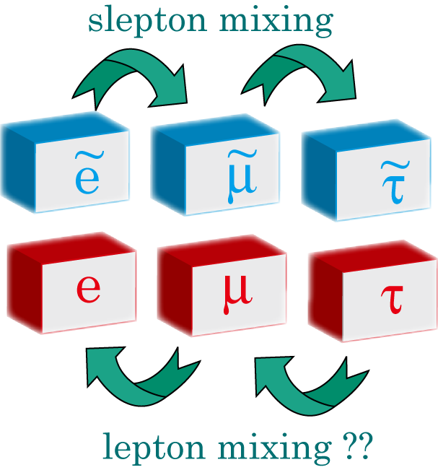
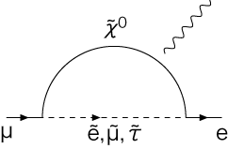
SUSY Flavor Problem
Non-minimal flavor violation
is predicted.
But, too large!
Introduction of SUSY breaking leads to new flavor violation, which induces leptonic and hadronic FCNC processes.
Slepton mass
matrix
lepton mass
matrix
SUSY breaking
Ex, when sleptons have off-diagonal terms in mass matrix,
C.f. , SM with predicts

Slide 8
SUSY Flavor Problem
Proposals for SUSY Flavor Problem
Introduction of SUSY breaking leads to new flavor violation, which induces leptonic and hadronic FCNC processes.
Universality (degeneracy)
Alignment
Decoupling
Slepton mass
matrix
lepton mass
matrix
SUSY breaking
Ex, when sleptons have off-diagonal terms in mass matrix,
C.f. , SM with predicts

Slide 9
Measurements of SUSY particle mass spectrum discriminate models.
（hisano@Nufact07)
But, SUSY flavor physics never ends
even after the universality is confirmed.

Slide 10
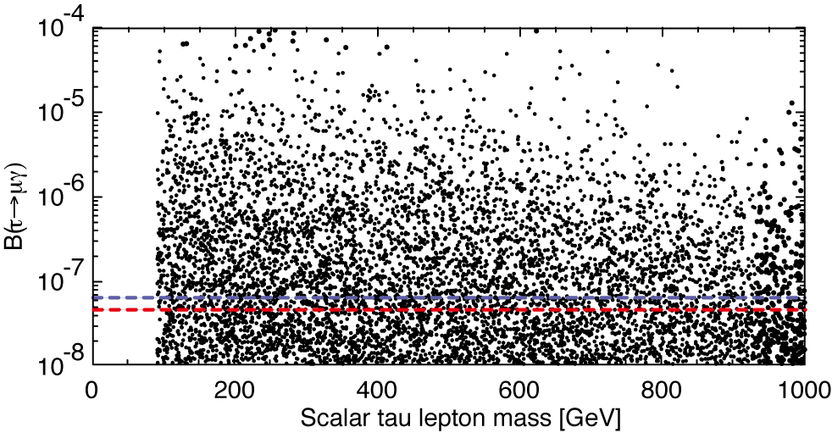
SUSY Seesaw in the universality
If the origin of the SUSY breaking is physics beyond the Seesaw scale, such as MSUGRA, LFV interaction in Seesaw sector induces LFV slepton mass terms.
SEESAW MODEL
Tiny neutrino masses
Leptogenesis
Compatible to SO(10) GUT
Typical case,
LFV studies probe physics beyond the SUSY SM.
(JH&Shimizu)

Slide 11
SUSY Seesaw in the universality
If the SUSY breaking comes form physics beyond the Seesaw scale, such as MSUGRA, LFV interaction in Seesaw sector induces LFV slepton mass terms.
(Boltzmati&Masiero)
Typical case,
but, larger branching ratio is possible due to accidental cancellation.
LFV studies probe physics beyond the SUSY SM.
(JH&Shimizu)

Slide 12
Alignment
Flavor symmetries control fermion and sfermion mass matrices.
Squark sector
Alignment cannot be satisfied with both and mixings.
Partial universality is required so that FCNCs are suppressed
Slepton sector
Alignment is possible.
GMSB with SUGRA contribution
Squark masses become heavier and more degenerate, and LFV seems to be more promising.
(Nir et al)

Slide 13
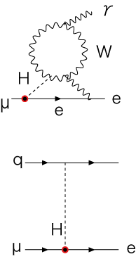
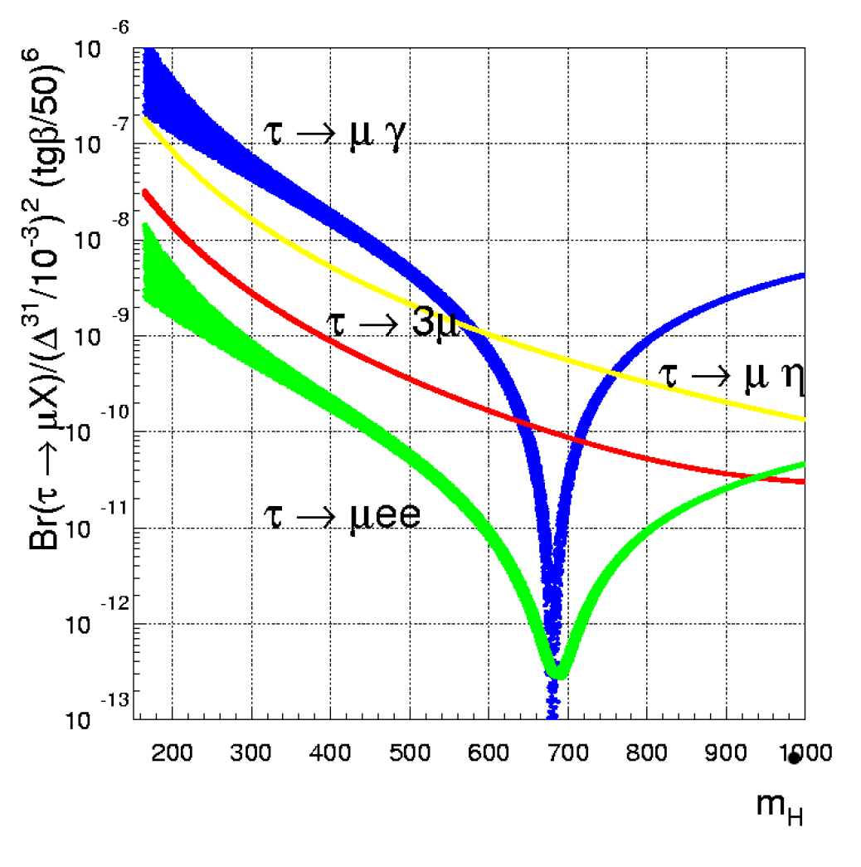
LFV in decoupling case
When SUSY particle masses are larger than O(1-10) TeV, FCNCs are suppressed below the experimental bounds even if squark and slepton mixings are not small.
Even in this case, the Higgs exchange
contributes to LFV processes since
SUSY SM has two doublet Higgs bosons.
LFV Higgs coupling is generated at one-loop.
τ
μ
Lesson:
When a new particle is found, we have to check whether it has LFV interaction or not.
τ
μ
(Paradisi)
Tree
One-loop
(Babu & Kolda)

Slide 14
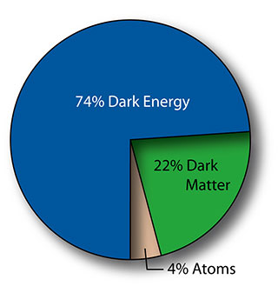
Cosmological issues to LFV in SUSY
Dark matter in Universe
Flavor physics and cosmology are tightly connected.
Neutralino is a good DM candidate, since thermal relic scenario can explain its abundance.
Origin of the SUSY breaking is SUGRA-type, and LFV may be promising.
Baryogenesis
Leptgenesis is well-motivated, but gravitino mass is constrained.
Light gravitino (<10eV): Low-energy gauge mediation
Maybe LFV is invisible.
Superheavy gravitino ( > 10TeV): Anomaly mediation
Minimal anomaly mediation predicts minimal-flavor violation,
but it is ruled out due to tachyonic slepton. In some realistic
models, LFV may be induced by the neutrino Yukawa in seesaw.
(Kitano et al)

Slide 15
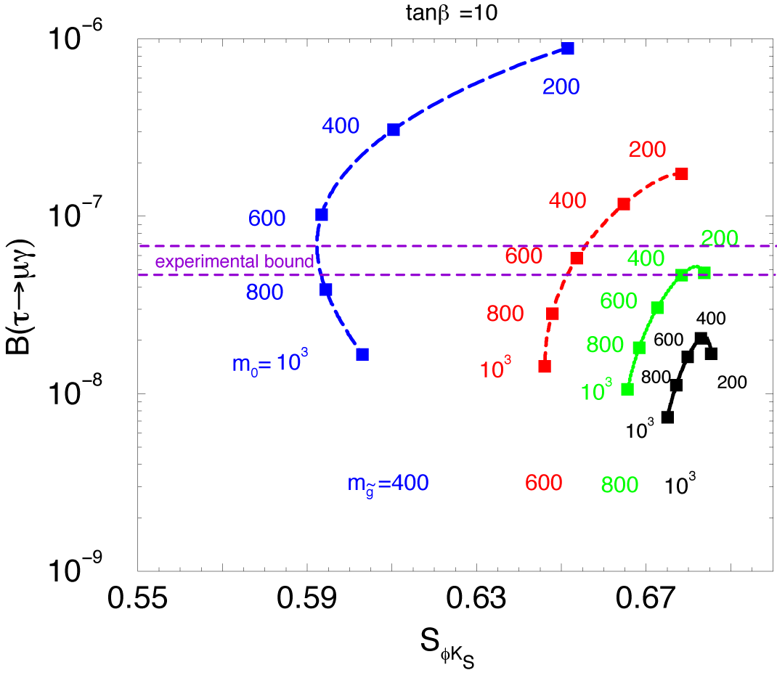
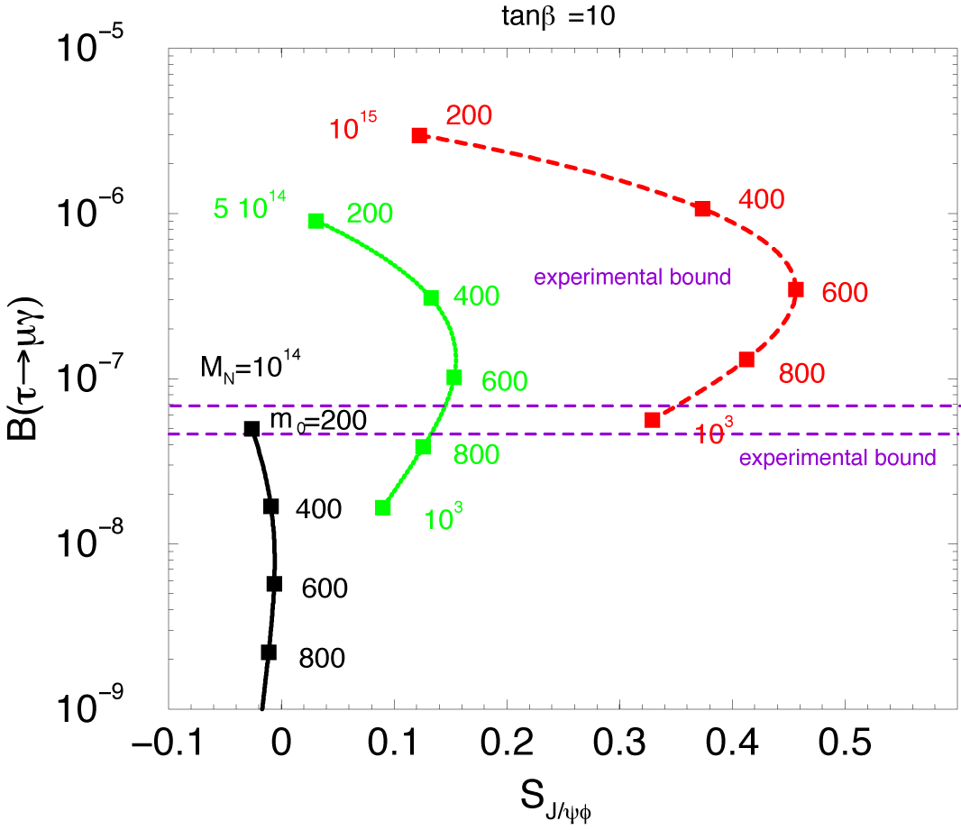
Read to SUSY GUTｓ
In GUTs, quarks and leptons are unified. LFVs are correlated with hadronic FCNCs.
SUSY SU(5) GUT with right-handed neutrinos
Neutrino Yukawa affects mass terms of left-handed sleptons and right-handed down squarks.
(JH&Shimizu)

Slide 16
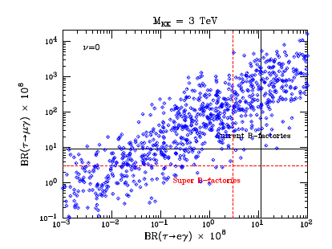
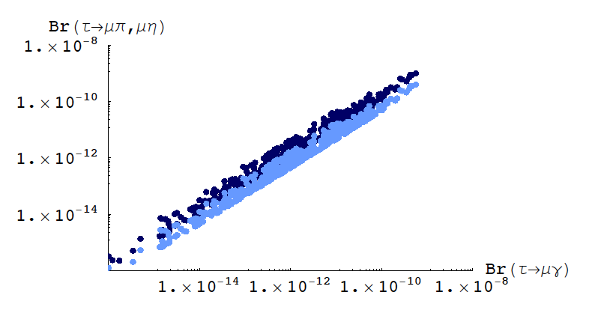
Non-SUSY models at TEVs
Many proposed TeV-scale models have new particles, which have lepton-flavor numbers or have lepton-flavor violating interactions.
SM on Randall&Sundrum BG
SM particles propagate over curved 5th dim. space.
Overlapping of wave functions of quark/lepton and Higgs explains hierarchical structure.
Kaluza-Klain particles have large flavor-violating interactions.
Lepton-flavor is violating in nature. If BSMs do not predict LFV, the models should have some mechanisms to suppress it.
(Agache et al)
Littlest-Higgs model with T parity
SM Higgs is pseude NG boson.
T parity is imposed to escape from EW precision test and also to introduce the DM candidate.
T-odd mirror leptons/quarks have flavor-violating interactions.
(Blanke et al)

Slide 17
Summary of my talk
Dark matter
Baryon asymmetry
(Inflation)
Search for lepton-flavor violation is powerful in exploration of TeV-scale physics. And, we may get a clue to physics beyond the TeVs.
LFV physics is linked with cosmology and collider physics, in addition to other intensity frontiers physics. Conspiracy among them will be fruitful.
Something at TeVs
for naturalness
Something at TeVs
for naturalness
Superstring
Standard Model
(+ neutrino mass)
Supersymmetry
Extra-dimension

