Slide 1
Current Status and Plan on Grid at KEK/CRC
Links to SAGA is additionally listed in reference slide (end of presentation file)
Institutes list is a bit revised (in slide: Institutes)
Go Iwai, KEK/CRC
On behalf of KEK Data Grid Team

Slide 2
Outline
Introduction
Deployment
VO specific operational statistics
Recent activities
Unified user-interfaces using SAGA*
Summary
* SAGA: A Simple API for Grid Applications

Slide 3
Introduction
Our role
Deployment status
VO scale
Resources
Institutes
Members
Ops stats
# of jobs
CPU consumption

Slide 4
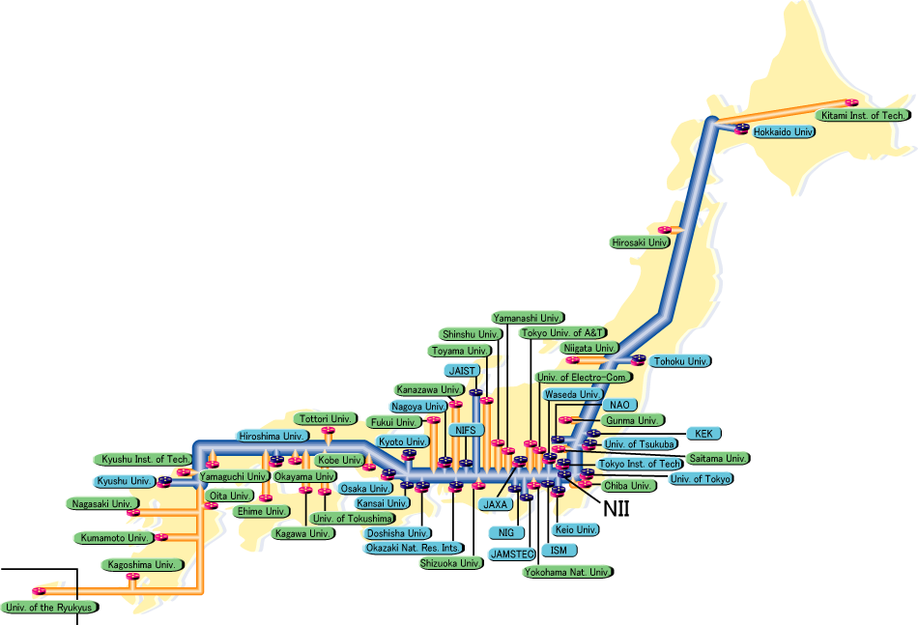
Introduction
Major HEP projects:
Belle, J-PARC, ATLAS ongoing projects
ILC, Super-Belle future projects
Also covering
Material science, bio-chemistry and so on using synchrotron light and neutron source
RT tech. transfer
We have a role to support university groups in these fields.
including Grid deployment/operation.
Nagoya Univ.
Tohoku Univ.
Kobe Univ.
KEK
Hiroshima IT
Univ. of Tsukuba

Slide 5
KEK’s Contribution in EGEE-III
TSA1.1: Grid Management
Interoperability and collaboration
TSA1.2: Grid operations and support
1st line support for operations problems
Middleware deployment and support
a) Coordination of middleware deployment and support for problems.
b) Regional certification of middleware releases if needed (outside of PPS and SA3 involvement). This is anticipated to be very rare and will require specific justification.

Slide 6
Logical Map Focused on Network Connection for Grid
Univ.
Grid
SINET
Univ.
Grid
Univ.
Grid
Univ.
Grid
Univ.
Grid
Univ.
UI
CA
VOMS
HPSS-DSI
SRB-DSI
KEK-1
NAREGI
KEK-2
LFC
Intranet
CC-GRID
GRID-LAN
DMZ

Slide 7
VO Component
SRM
Directory access by TURL, not using any logical namespace so far
SRB-DSI
GridFTP
SRB
Inside B-Comp. System
HSM
Looking up logical file name
Service/Resource discovery
Req./Booking comp. res.
Logon VO & privilege mgt
Unified IF into the LRMS
Unified IF into the storage equip.
Belle VO specific arch.
Virtual Organization
LFC
VOMS
RB
SRM
CE
IS
Central Services for Belle

Slide 8
Brief Summary of LCG Deployment
JP-KEK-CRC-01 (KEK-1)
JP-KEK-CRC-02 (KEK-2)
Production in GOC since Nov 2005
Mainly operated by KEK staffs
Site Role:
Practical operation for KEK-2
Getting’ started for university groups
Resource and Component:
SL-3x or SL-4x
gLite-3.X
CPU: 14
Storage: ~7TB for disk and DSI for HSM, HPSS
Fully functional services
Supported VOs:
belle apdg ail g4med dteam ops ppj ilc calice naokek
Production in GOC since early 2006
Site operation:
Manabu and Kohki
Site Role:
More stable services based on KEK-1 experiences.
Resource and Component:
SL-3x or SL-4x
gLite-3.X
CPU: 48
Storage: ~1TB for disk
Fully functional services
Supported VOs:
belle apdg ail g4med dteam ops ppj ilc calice naokek
In plan to upgrade
In Q1 of FY2009
Fully upgrade and up soon!
10WNs x 8CPUs x ~4kSI2K
Storage capability on demand basis
HPSS virtually works as the backend disk of SE
~200USD/1TB
VM (Xen) technologies are widely supported in whole site
Higher availability & more robustness
Old blade servers (B-Comp) are now being integrated with KEK-2
250 x 2CPUs

Slide 9
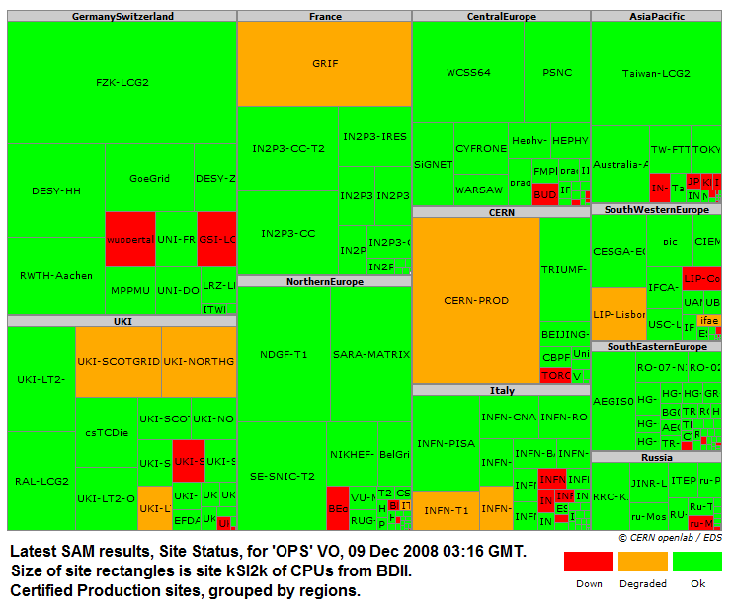
LCG Infrastructure Deployment Status
~10MSI2K
55 countries
265 sites
88K CPUs
130M SI2K
480 PB available
580 PB in use
As of Dec 2008

Slide 10
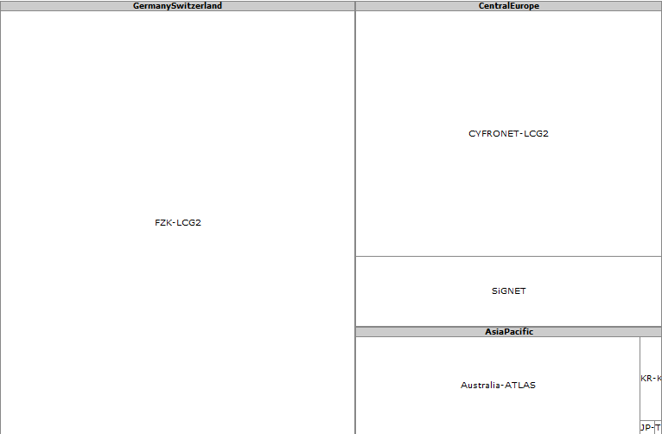
Resource Deployment over belle VO
Note: Still missing KEK-2
18M SI2K/9k CPUs
~10% of whole production resources
10MSI2K
FZK-LCG2
Storage through SRMs
27 TB available
83 GB in use
HSM storage in KEK Belle Computing System through SRB
~100 TB (ask Nakazawa-san in detail)

Slide 11
Institutes
VO-scale is being expanded slowly
IFJ PAN (CYFRONET) (Poland)
Univ. of Melbourne (Australia)
KEK (Japan)
National Central Univ. (Taiwan)
ASGC (Taiwan)
Nagoya University (Japan)
KISTI (Korea)
Univ. of Karlsruhe (Germany)
Jozef Stefan Institute (Slovenia)
Panjab Univ. (India)
Virginia Polytechnic Inst. State Univ. (US)
Univ. of Hawaii (US)
Wayne State University (US)
Korea Univ. (Korea)
Univ. of Sydney (Australia)
Federation done

Slide 12
Members
90% of 22 persons is ops staff
/C=JP/O=KEK/OU=CRC/OU=KEK/CN=Nishida Shohei
/C=JP/O=KEK/OU=CRC/OU=KEK/CN=Yoshimi Iida
/C=JP/O=KEK/OU=CRC/CN=Go Iwai
/C=JP/O=KEK/OU=CRC/OU=Nagoya/CN=Yuko Nishio
/C=AU/O=APACGrid/OU=The University of Melbourne/CN=Glenn R. Moloney
/C=JP/O=KEK/OU=CRC/OU=Korea University/CN=Hyuncheong Ha
/C=JP/O=KEK/OU=CRC/CN=Yoshiyuki WATASE
/C=JP/O=KEK/OU=CRC/CN=Hideyuki Nakazawa
/C=JP/O=KEK/OU=CRC/CN=YAMADA Kenji
/C=JP/O=KEK/OU=CRC/OU=Nagoya university HEPL/CN=kenji inami
/C=JP/O=KEK/OU=CRC/OU=Nagoya university HEPL/CN=Mitsuhiro Kaga
/C=JP/O=KEK/OU=CRC/CN=Jun Ebihara
/C=JP/O=KEK/OU=CRC/OU=Korea University/CN=Soohyung Lee
/C=JP/O=KEK/OU=CRC/CN=Manabu Matsui
/C=SI/O=SiGNET/O=IJS/OU=F9/CN=Marko Bracko
/C=JP/O=KEK/OU=CRC/CN=Kenn Sakai
/C=JP/O=KEK/OU=CRC/CN=Yugawa Takahiro
/C=JP/O=KEK/OU=CRC/CN=Yamada Chisato
/O=GermanGrid/OU=Uni Karlsruhe/CN=Thomas Kuhr
/O=GermanGrid/OU=FZK/CN=Dimitri Nilsen
/C=KR/O=KISTI/O=GRID/O=KISTI/CN=84035421 Beob Kyum Kim
/C=JP/O=KEK/OU=CRC/CN=Shunsuke Takahashi

Slide 13
Ops Stats: JFY2006 & JFY2007
Submitted Job @ KEK-2 & KEK-2
100 kJobs
300 kHrs
CPU Consumption @ KEK-1 & KEK-2

Slide 14
Ops Stats: JFY2008
Now
18 kJobs
170 khrs

Slide 15
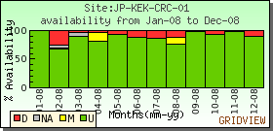
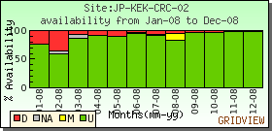
Service Availability Jan-Dec 2008
More than 90% availability in 2008 !
931H/12SD
13 tickets were opened, but solved all
127H/4SD
12 tickets were opened, but solved all

Slide 16
Recent Activities SAGA-A Simple API for Grid Applications
Motivation
Goal
Current Status

Slide 17
Grid Deployment at KEK Middleware/Experiment Matrix
Commonly most of experiment or federation are using gLite as the Grid middleware.
NAREGI middleware is being deployed as the general purpose e-science infrastructure in Japan
Difficulties: e.g. human costs, time differences
Both interops among MWs are mandate for us (next a few slides)
To provide higher availability, reliability and to keep prod. quality
 | gLite | NAREGI | Gfarm | SRB | iRODS
Belle | Using | Planning | Using | Using
Atlas | Using
Radio therapy | Using | Developing | Planning
ILC | Using | Planning | Planning
J-PARC | Planning | Planning | Planning |  | Testing
Super-Belle | To be decided by 2010

Slide 18
Issues on Multi Middleware Apps
For site admins:
Dedicate HW is deployed in each middleware
LRMS
OS
For end users:
By ordinal way, same apps for each middle are developed to be enabled on Grid
They have to know which middleware they are using.
Users should be aware the underlying middleware-layer and hardware deployed
App
App
App
SRB
iRODS
NAREGI
gLite
Storage
Storage
Storage
CPUs
CPUs
Deployed dedicate HW

Slide 19
Motivation
We need to operate multi Grid middleware at the same time.
Resource sharing among them is mandate
We are also contributing to GIN
Virtualization of Grid middleware is our wish
The best scenario for the application developers
Applications
SAGA-Engine
Adpt
Adpt
Adpt
SAGA adaptors
Today’s topic for SAGA-NAREGI
GIN/PGI: Multi-Middleware Layer
SRB
iRODS
NAREGI
gLite
Cloud
LRMS
LSF/PBS/SGE/…
CPUs
Storage
Fair share resources among middles

Slide 20
Project Goal (Funded collaboration with NII)
SAGA supports cloud & LRMS for local clusters
2.
Svc
Svc
Apps
Apps
RNS
FC service based on OGF standard
Python Binding
C++ Interface
SAGA-Engine
Adpt
Adpt
Adpt
SAGA adaptors
1. GIN/PGI: Multi-Middleware Layer
SRB
iRODS
NAREGI
gLite
Cloud
LRMS
LSF/PBS/SGE/…
Storage
CPUs
Middleware-transparent layer
Middleware-independent services

Slide 21
Current Status SAGA-NAREGI Adaptor
Only for the job adaptor
Succeed to submit a job in NAREGI and to retrieve results
saga::job::description jd;
jd.set_attribute(sja::description_executable, "/bin/hostname");
jd.set_attribute(sja::description_working_directory, "/some/where/work/dir");
jd.set_attribute(sja::description_output, “std.out");
jd.set_attribute(sja::description_error, "std.err");
std::vector <std::string> ft;
ft.push_back("gsiftp://gfarm.cc.kek.jp/my/file.in > file.in");
ft.push_back("gsiftp://gfarm.cc.kek.jp/my/file.out < file.out");
jd.set_vector_attribute(sja::description_file_transfer, ft);
saga::job::service js("naregi://nrgvms.cc.kek.jp");
saga::job::job j = js.create_job(jd);
j.run();
while (j.get_state() != saga::job::Done) {
std::cout << j.get_attribute(“JobID”) << std::endl;
sleep(1);
}
Job description
File stage-in/out
Job Submission

Slide 22
Summary

Slide 23
Summary
Belle VO has being expanded
9 institutes and 22 users
18M SI2K/9k CPUs
27 TB available, 83 GB in use through SRMs
HSM in KEK Belle Computing System Is used through SRB.
KEK-2 will come up very soon
Final state to pass certificate process
SAGA-NAREGI ready for use
Only for job adaptor currently
SAGA-PBS is now being developed and will be released soon (in March 2009)
This project has been funded for 3.5 years and end in March 2012.

Slide 24
References
SAGA
http://saga.cct.lsu.edu/
http://forge.ogf.org/sf/projects/saga-rg
VOMS end point
https://voms.kek.jp:8443/voms/belle/webui/request/user/create
VO setting parameters
https://voms.kek.jp:8443/voms/belle/webui/config
VO ID card
https://cic.gridops.org/index.php?section=vo&page=homepage&subpage=&vo=belle
VOMS certificate
http://voms.kek.jp/voms.kek.jp.10684
https://cic.gridops.org/downloadRP.php?section=database&rpname=certificate&vo=belle&vomsserver=voms.kek.jp
VOMS.kek.jp will move to VOMS.cc.kek.jp in next power cut August 2009.

