Slide 1
Summary of the SVD session
19 March 2009
T. Tsuboyama (KEK)

Slide 2
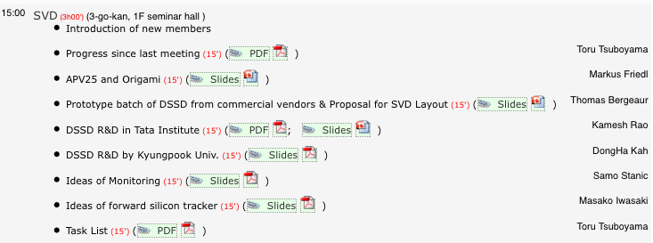
Agenda of the meeting

Slide 3
Progress after the last meeting
HPK DSSD production
HPK showed an intention to restart DSSD production but has not give us their decision.
→ Bergeaur’s talk
APV25 purchase
We bought 4000 chips, just enough for SVD production.
→ Friedl’s talk.
IR discussion started with engineers → Iwasaki’s talk
Super BEAST → If SVD/PXD is not installed at T=0, we need a radiation measurement system.
Hara moved from Osaka to KEK.
His main task is computing and software for the Super BELLE.

Slide 4
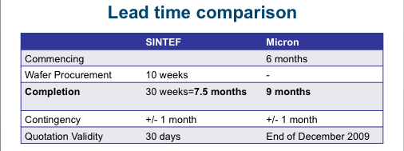
DSSD prototyping (Bergeaur)
Prototype of a double sided sensors from 6” wafer are important in order to examine the Origami concept.
Quotations from Micron and SINTEF were compared.
From view point of technology, both company gave reasonable answer.

Slide 5
DSSD prototyping (Bergeaur)
Cost: SINTEF = Micron *2.
SINTEF is more communicative than Micron.
Micron has only 1 for each job.
If HPK does not answer soon, we should start with Micron.

Slide 6
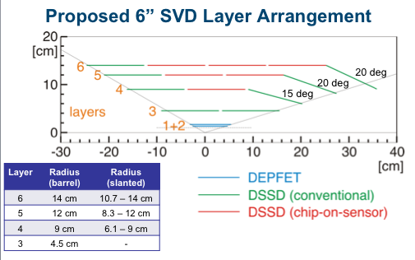
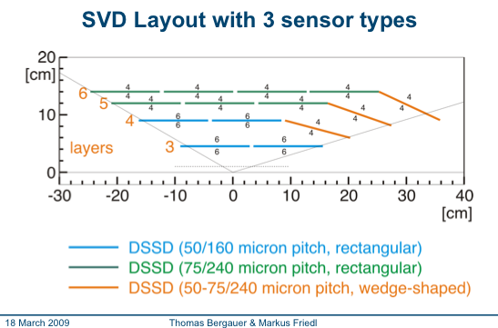
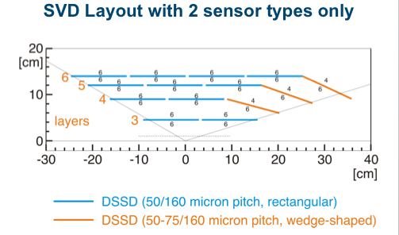
Proposal for DSSD layout (Bergeaur)
With sensor from 6” wafers, SVD can be build by using just two type of sensors.
horizontal: rectangular
slanted: trapezoidal
In order to save number of APV25 chips, wider readout chip in the outer two layers.

Slide 7
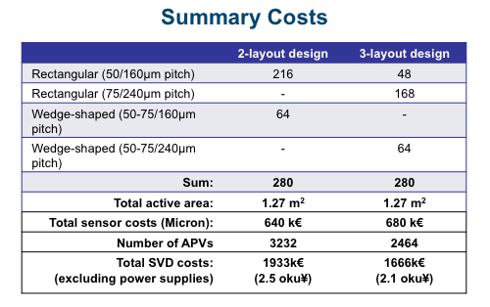
Cost estimate
Calculation is done assuming Micron sensor.
DSSD production cost
=Σ(setup cost + sensor cost)
Number of APV chips and DAQ system is reduced in “3-layout” design.
In total, 3-layout design is slightly cheaper.
Power supply and COPPER/FINNESSE is not included in the cost.

Slide 8
APV25 and Origami (Frield)
4,000 chips were purchased.
1,500 chips will be thinned.
First wafer was thinned and diced in a French company.
Result is excellent.

Slide 9
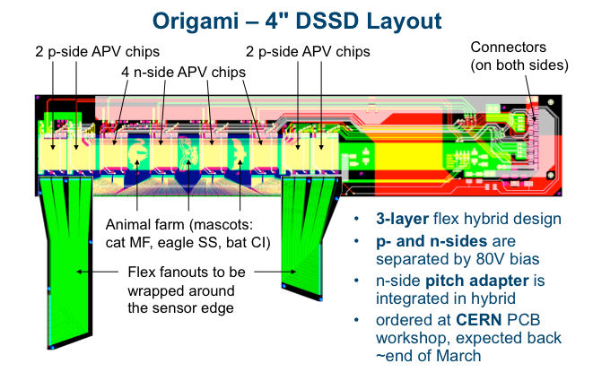
Origami concept (Friedl)
Origami scheme is necessary to read out large area detector with APV25.
At cost of 0.3% X₀, high S/N is assured.
The strips in back is readout with APV25 on top of the sensor.
First PCB is in production by CERN. Test of origami scheme will be done soon.

Slide 10
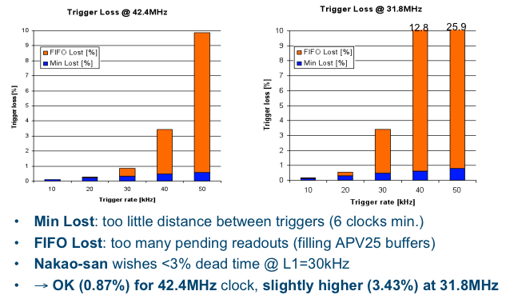
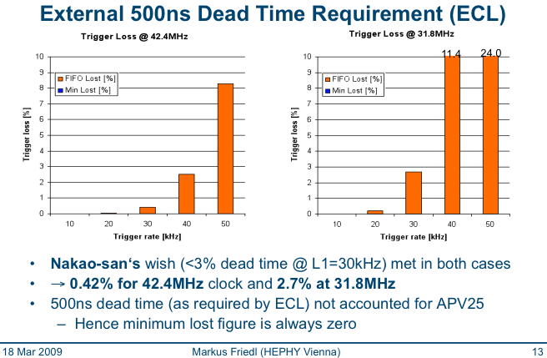
Trigger issue
GLD decision requires ~5 μsec.
At 42 MHz, the 192 stage pipeline of APV25 can hold data for 4.6 μsec.
At 32 MHz operation, pipeline can hold data for ~6 μsec.
Dead time > 3% at 30 kHz trigger rate.
With >500 nsec between adjacent triggers, the problem is relaxed.

Slide 11
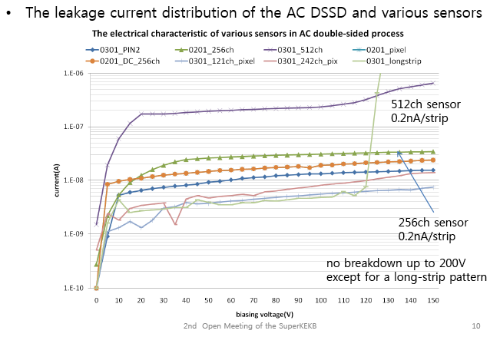
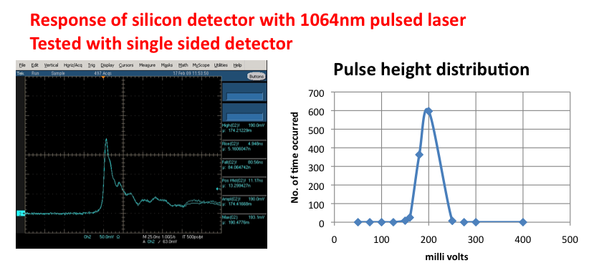
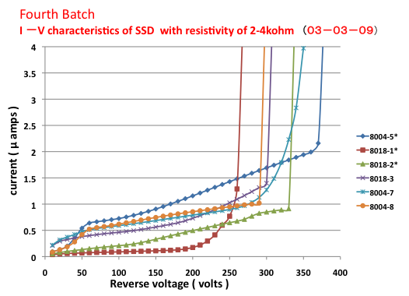
Detector R&D
R&D in Korea and India are now in good shape.
Kyungpook Univ.: DongHa Kah Tata institute: K. Kameswara Rao

Slide 12
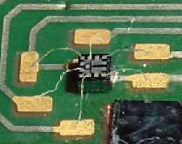
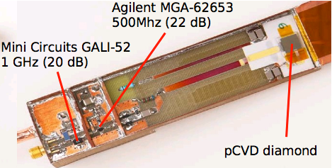
Monitor (Stanic)
RADFETs are useful in the present SVD
Are RADFET chips still available?
Total dose can be estimated using sensor damage.
Diamond sensor for radiation measurement and : In SVD3, we discussed to install several chips to silicon ladder.
Temperature sensors are also
Position monitor?

Slide 13
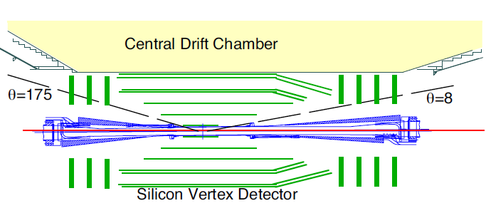
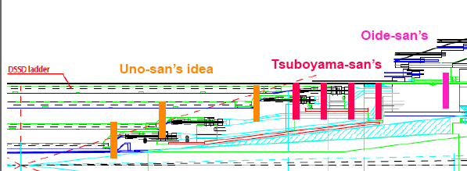
Foraward detector (Iwasaki)
Purpose
Extend the Belle acceptance to improve physics potential.
Measure the e+ or e- which is generated in the e+e- interaction and scattered by beam. Then the beam size measurement becomes possible.
For 2, random triggered data should be used.
If enough space is not available, we must consider to extend the angular acceptance of SVD

Slide 14
TASK LIST

Slide 15
Software
Online:
Cluster finding and time reconstruction
Calibration
Performance monitor
Data quality monitor
Quality assurance monitor
Offline
Calibration / Database
Alignment
For physics study, much better svd/pixel alignment and reliable tracking (CDC+SVD+PIXEL) is necessary
Tracking
CDC track extrapolation
Local SVD/Pixel tracking
Simulations
Detector optimization

Slide 16
DSSD production
No news from HPK
Test production by other companies (Talk by Bergauer)
R&D in Tata institute (Talk by K. Rao)
R&D in Kyunphook Univ. (Talk by Kah)
Mass production
Sensor characterization.
Quality control

Slide 17
Readout
APV25 hybrid
Normal and Origami
Production
Quality control --- Test
Repeater
Mechanical and Electric design
Mass production
Backend
COPPER/FINNESSE – How many crates are necessary?
Mass production
DAQ software
Slow control

Slide 18
Mechanics
Support
Joint work with IR/DEPFET/Strip design is necessary
Connection to CDC/IR/DEPFET
Design: Cooling of normal hybrids
Construction
Ladder production
Design
DSSD test
Hybrid test
Assembly
Storage
Booking
Ladder test

Slide 19
Infrastructures
Monitor
Radiation and Beam abort
Temperature
Cooling
Chiller/coolant
tubing
Special consideration of Origami cooling tubes
Cables
Power supply / signal / control /
Power supply
Design, construction (purchase)
Place
3 times larger system than the present SVD
DEPFET group need a big power supply system, also.
Readout
Crates

Slide 20
System integration
Definition of Integration strategy.
Ladder mount
Test with source /laser (?)
Debugging hardware and software
Calibration
Cosmic ray test
Commissioning Pixel + SVD should be done together.

Slide 21
Forward detector
Talk by Iwasaki
Purpose
Improve physics performance
Beam size measurement
Design should be done in parallel to the SVD design.
How about just extend the acceptance of the SVD.

Slide 22
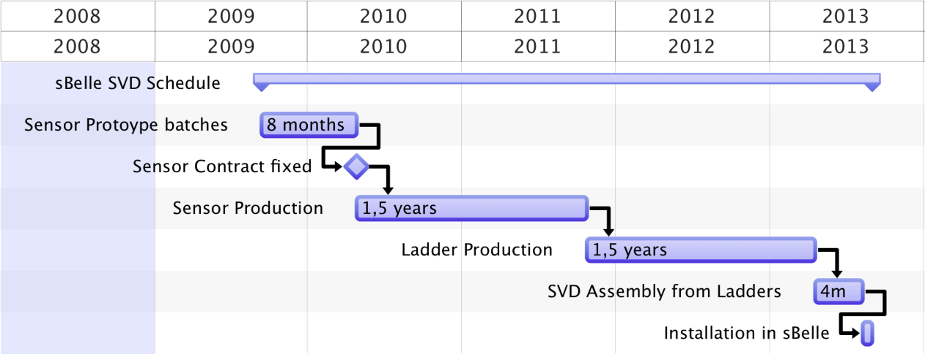
Production schedule
Thomas’s chart (modified) in a previous meeting.
3 years for sensor production with some spares.
Final ladder production will be done in 2013.
0.5-1 year system test before installation.
SVD and DEPFET installation should be done after we understand background conditions, e.g., 0.5 years.
Super BEAST team is necessary
system test

Slide 23
Production speed
100-150 DSSD per year * 3 years.
24 ladders per year * 3 years.
72 ladders installation in the last year.
DSSD production hopefully starts at end of 2009.

