Slide 1
Light Output measurement of BSO scintillator
2009/July/7th
Tomoko Iwashita/Kenkichi Miyabayashi

Slide 2
Outline
Motivation
BSO is an alternative option;
Heavier and longer wavelength(~480nm).
Checked Light Output of small samples quickly.
Set up
ADC distribution
PureCsI
BSO
Compared with PureCsI
Summary and plans

Slide 3
Set up
Threshold
20mV～30mV
Width 500ns
Veto 1ms
Scintillator
Optical grease
Discri
G.G.
Charge-sensitive ADC(LeCroy2249W)
PMT
AMP
Div
AMP
ATT
Radiation source 137Cs(662keV)
To match ADC range
・PMT : H3167(19mmφ)
Borosilicate glass window
Bialkali photocathode
HV → 1650V

Slide 4
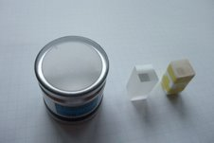
Samples
PureCsI
1φ×2cm
BSO
1*1*2cm³ BSO both ends mirror polish, 4 side surfaces are frosted.
Wrapped by white Gore-TeX film.

Slide 5
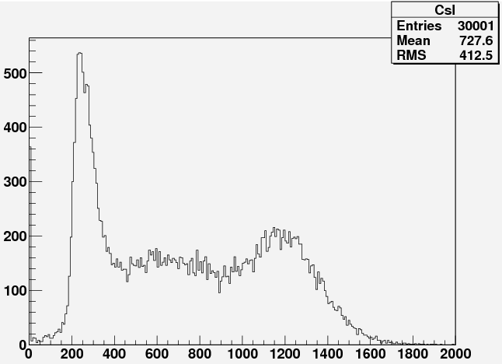
ADC distributionof PureCsI
Size : 1φ×2cm. (λ=330nm)
Photoelectric peak
Compton scattering
Around photoelectric peak is magnified as right figure, together with fitted line by Gaussian.

Slide 6
ADC distribution of BSO
Size : 1cm×1cm×2cm.
(Purity 99.9999%, λ=480nm)
ATT 6dB : To adjust ADC range.
Photoelectric peak
Compton scattering
Right figure is magnification around photoelectric peak.

Slide 7
To compare with PureCsI
BSO SA, SB and No.1 are different samples; all purity 99.9999%.
BSO exhibits double effective L.O. because of longer wavelength!
L.O. (PureCsI equal 1 )
As for Pr:LuAG,
see 2008 Dec. meeting slides
.
Sample
L.O. of BSO is two times as PureCsI.

Slide 8
Comments on sample dimension and surface finishing.
Light collections for PureCsI(cylindrical)=BSO(1X1X2cm³) assumed.
In order to make sure, PureCsI (1X1X2cm³) ordered, delivered in 3 weeks.
Then answer becomes clearer.

Slide 9
Actually we experienced;
x
Common phenomena in crystal with n>sqrt(2).
L.O. of 2x2x2cm³ BSO(all 6 surfaces mirror polished) exhibits ~ half of 1x1x2cm³(only both end surfaces are mirror polished) sample.
Though they are taken from the exactly same block.
Thought to because of photon’s total reflection at its polished surfaces ~45 deg.
Significant amount of photons are absorbed during travel inside crystal…
Notes:
9

Slide 10
Summary and plans
Effective L.O. of BSO is 2 times as high as PureCsI because of longer wavelength.
1*1*2cm³ PureCsI (Both ends mirror polish, 4 side surfaces are frosted) will be gotten soon.
To remove possible light collection difference .
Radiation hardness test of BSO(and Pr:LuAG) small samples.

Slide 11
Back up

Slide 12
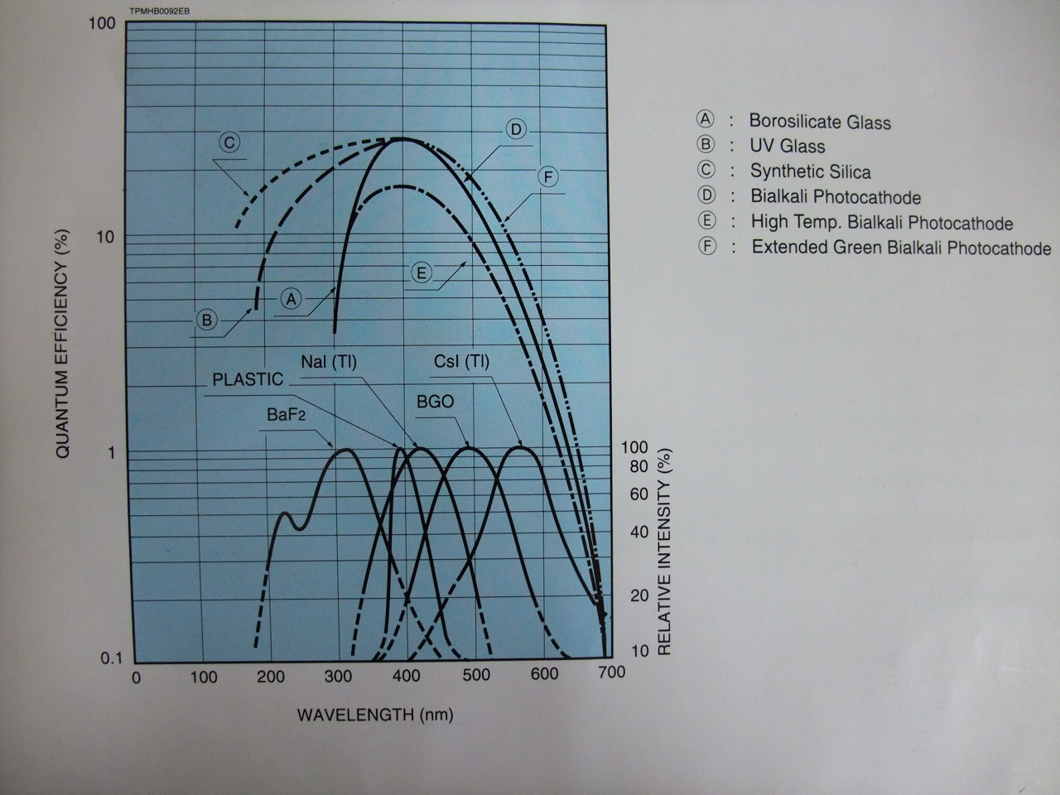
Typical Photocathode Spectral Response and Emission Spectrum of Scintillators
PureCsI
BSO
From HAMAMATSU text

