Slide 1
CDC readout system status
MT 2009 July 7

Slide 2
BELLE II
CDC readout electronics
CDC

Slide 3
Prototype CDC readout card (FY2009)
# of channels(Total:～15000)
48～64ch/board
Amp shaper
Shaping time:～100nsec
Gain:～1V/1pC（TBD)
Dynamic range:2pC（TBD)
TDC → FPGA TDC
Timing resolution:1nsec
ADC
Resolution:10bit
Sampling rate:～32MHz
L1 buffer
Depth:5usec max
Test board was developed to determine above params
using test chamber.

Slide 4
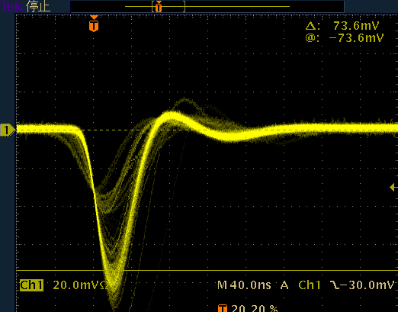
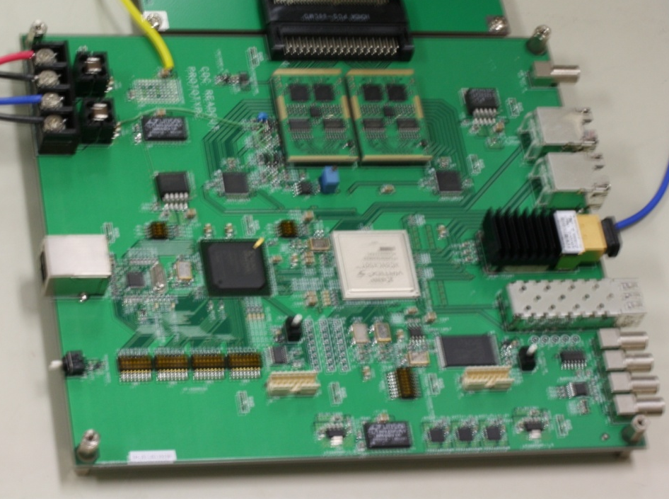
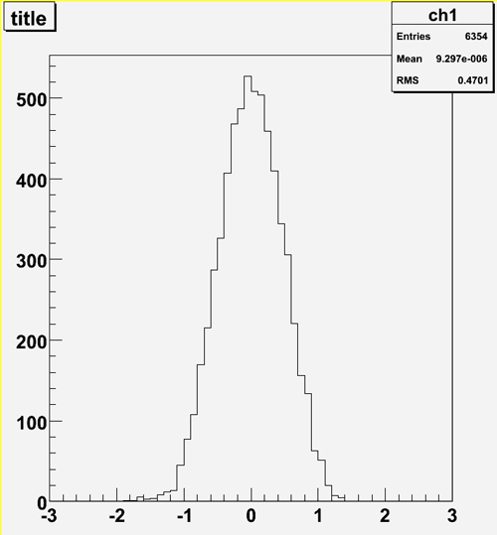
Test board for test(prototype readout card will be designed based on this.)
Small tube chamber (tungsten wire)
Fe⁵⁵ 5.9 keV X-ray
Gas(Ar90%+CH₄10%), P10 Gas
1.65kV
This AmpShaper was developed for other application.
Modification will be done by Dr. Taniguchi.
RocketIO will be tested by Dr. Igarashi
Firmware design will be done by Dr.Uchida
FPGA-TDC has been used for J-PARC.
Ampshaper
16ch
AD9212x2
RocketIO
RMS=0.47ns
TDC&L1 buf
PCB was designed by Mr. Saito and Mr. Ikeno

Slide 5
Specification of Test board(detail)
Analog(Amp-shaper for DB-decay exp)
Peaking time:～50nsec → OK
Pulse width:～200nsec → OK
Gain : 8V/pC → 1～２V/pC
Dynamic range : 2V max → OK
Noise : ～2500 e @ 40pF → OK
Function
ADC 10bit 32MHz
TDC 1nsec
L1 buffer : 5usec max
Two modes for data format
Waveform data readout mode
Compression mode Timing and Q
BLR modification has been done
These values will be confirmed by beam test

Slide 6
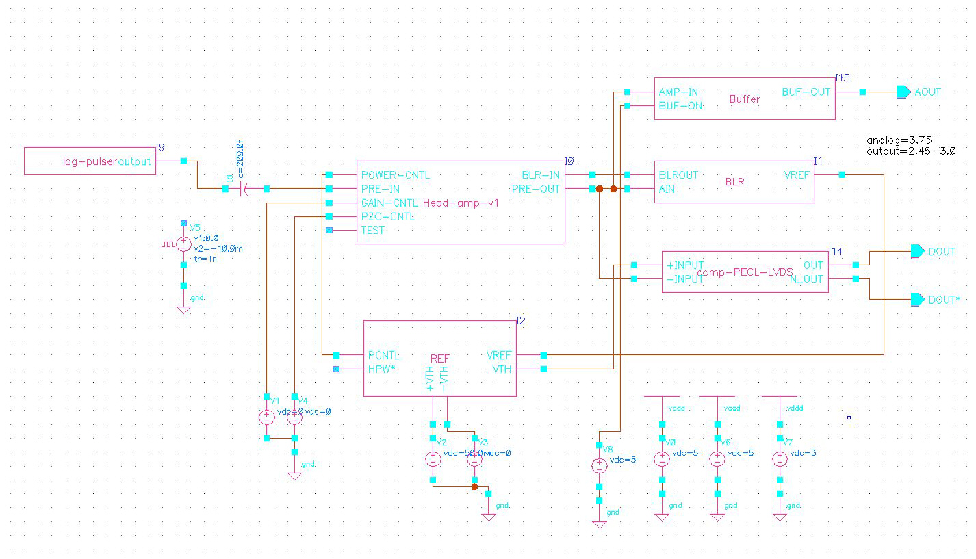
Amp shaper modification
We started development of Amp-shaper for BELLEII CDC.
Present Amp shaper
Analog buffer
BLR
Amp shaper
CMOS digital
Bias circuit

Slide 7
FPGA Block diagram
Trigger
FADC I/F
Ring buffer
5usec
500nsec window
Readout
FIFO
Q(sum)
&
Data formatter
SiTCP
Or
RocketIO
I/F
ADC
TDC
ASD
Slow control
DAC, ADC, Ring buffer etc

Slide 8
Function
L1 buffer length : 5usec Max variable
Window(for Q info:Σ) 500nsec variable
ADC waveform
old
New
Comparator output
Trigger
Timing data and Q or waveform data are
Transferred to external interface
Data format will be determined within a month

Slide 9
Schedule(short term)
End of Aug.
End of Sept.
Mid of Oct.
prototyping
Firmware
w/o rocket IO
modification
Uchida
Preparation for beamtest
Design and feedback
submission
Amp shaper
Taniguchi, Shimazaki
Test with rocket IO
Nakao, Igarashi
PCB design
Saito, Ikeno

